Slide 1
Welcome
Notes:
Thank you for taking the time to attend this meeting!

Slide 2

Sounds~Write: a linguistic phonics programme
Our new phonics approach
www.sounds-write.co.uk
Notes:
This is the phonics scheme that we are now using. All staff in KS1 and several members of KS2 have recently done 6 week intensive training. The programme is highly recommended to all schools by the government, as positive results have been seen from many schools for years now.
As a trust, we are all moving towards this new way of teaching phonics and there is lots of evidence to suggest the positive outcomes.

Slide 3
To become fluent readers and spellers children need to know:
  1: Letters are used to spell individual sounds (one at a time, from left to right across the page).
Notes:
There are 4 concepts that children will learn within sounds write. First, that our language is made up of sounds, and that letters are used to represent the individual sounds in the language. That is why the programme is called Sounds-Write. We start from the sounds, which is what the children already know, and we teach them how those sounds are spelt.

Slide 4
  2: Each sound may be spelled by one or more letters.
  cat ship night weight
Notes:
We then also teach the that each sound may be spelled with more than one letter. /k/ /a/ /t/ each sound is spelled with one letter
ship - three sounds: /sh/ /i/ /p/ - /sh/ is two letters, but it’s one sound
night – three sounds, /n/ /igh/ /t/- /igh/ is three letters, but it’s one sound
weight – three sounds, /w/ /eigh/ /t/, /eigh/ is four letters, but it’s one sound
So, you have one-letter, two-letter, three-letter and four-letter spellings.
When your child first starts to learn to read and write, we start with one letter spellings and we only move on to more complex spellings once they are secure with the one letter spellings.

Slide 5
  3: Sounds may be written in more than one way:
  play, rain, great, gate
Notes:
Sounds may be written in more than one way, such as in the sound ‘ay’.

Slide 6
  4: Many spellings represent more than one sound.
  the spelling < ea > can represent the sounds:
  seat, head, break
Notes:
The final concept is that many spellings represent more than one sound
So the spelling < ea > can represent the sounds: seat, head, break.

Slide 7
What skills need to be practised and perfected to become a fluent reader?
  Segmenting
  Blending
  Phoneme manipulation
  You also need code knowledge: how to spell the sounds in the language.
Notes:
Lessons that are taught within this phonics programme will support children learning these skills. Segmenting is when children know the individual sounds in a word. Blending is when children blend sounds together to make a word. Phoneme manipulation is when children are abe to swap sounds in a word to make a new one…e.g sound swapping game.

Slide 8
Initial code
Extended code
Notes:
We will no longer be using phases and the letters will not be taught in the same order as before. Instead of starting with s a t p i n and teaching each letter at a time…the children will be taught each set of codes altogether in word form, rather than individual letters at a time. Please see the initial code and extended code verviews in your handout.

Slide 9
Sounds-Write is all about focusing on not having to ‘re-teach’ something.
Notes:
For example, is we say to children this is how we spell ‘ay’, then we have to unteach this later on when children have the thinking that that is the only way to spell the /ay/ sound. Please see your handout for many other examples of this.

Slide 10
Key information…
Letters spell sounds
Pacific ocean- the same letter can make a different sound
NO tricky words
Split spellings
No actions/pictures linked to each sound
No silent letters
No ‘curly C’ and ‘Kicking K’
Children should always say the sound as they write them.
Notes:
-Letters SPELL sounds, not make sounds (we make the sounds).
-SW teaches by words rather than separate sounds, as letters do not always make the same sounds and will then need to be un-taught later on. E.G- ‘pacific ocean’.
-No such thing as tricky words- we can sound all of them out.
-Split spellings, not split sounds ( the sound is not split).
-No actions or pictures linked to the sounds, as this gives the children more to learn.
-No such thing as silent letters, they’re just another way of spelling the sound.
-We don’t say ‘curly C’ and ‘kicking K’, there just other ways of spelling the /c/ sound.
-Always get children to say the sounds as they write them!!!!

Slide 11
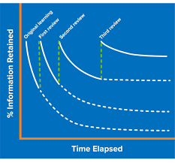
Books
Reading books that are linked to a unit before in EYFS and Year 1.
For example, If a child is being taught unit 4 in the initial code, then they will be reading a book with unit 2 or3 sounds in to consolidate their learning.
Notes:
Children will be getting their new books once they have arrived. Reception will get a unit 1 book when they are learning unit 2.

Slide 12
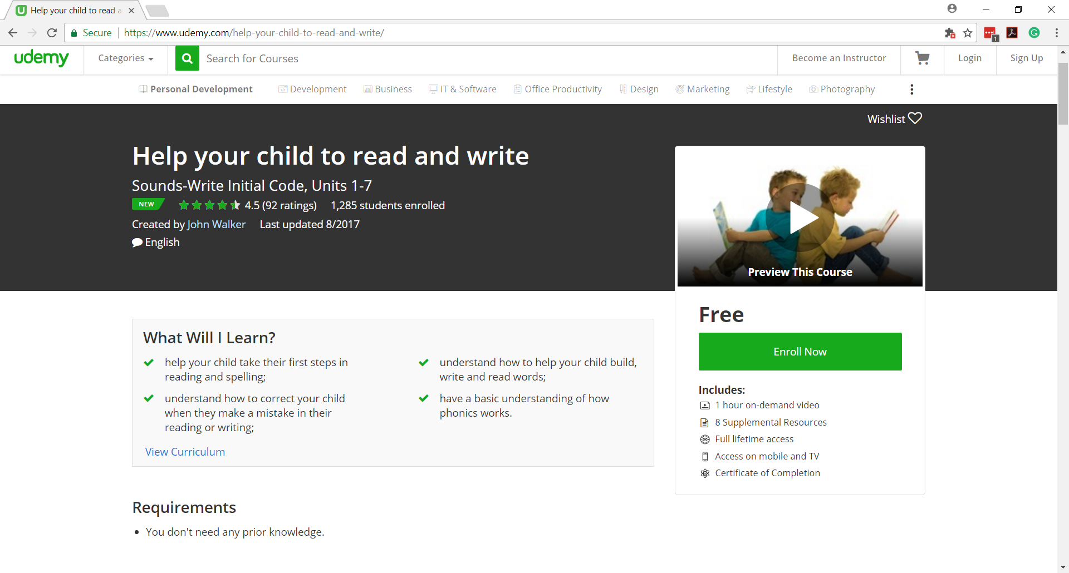
https://www.udemy.com/help-your-child-to-read-and-write/
Notes:
This is a free, online course called ‘Help your child to read and write’, which has been specifically written by Sounds-Write to show parents how to help their children when using the Sounds-Write phonics programme.

Slide 13
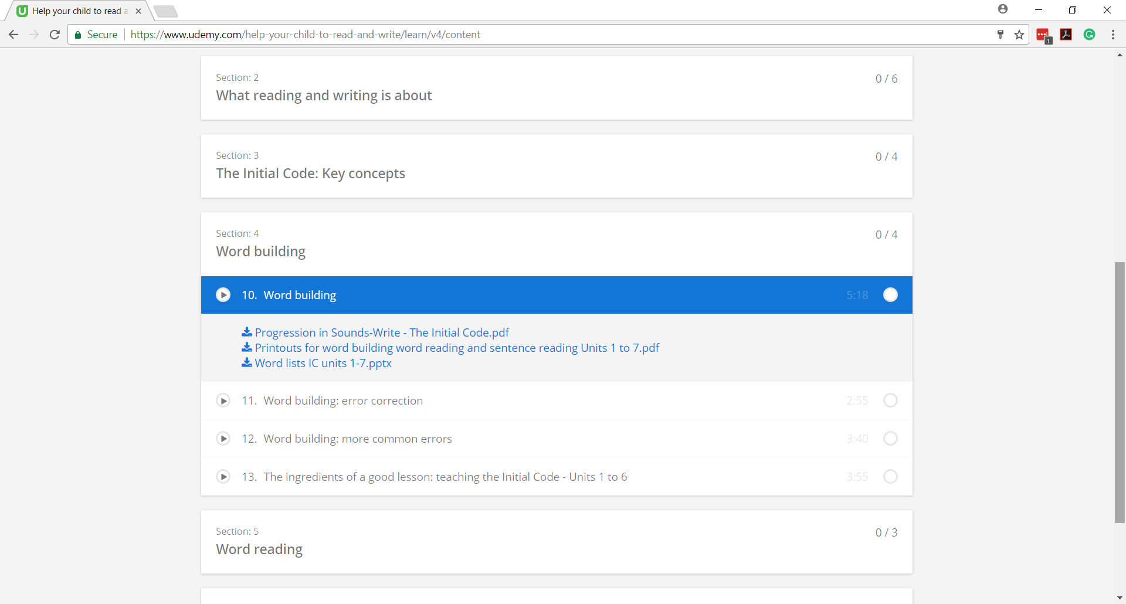
Notes:
There are also lots of additional resources on the website so that you can practise at home with your child., if you wish to do so.

Slide 14
Free online course
www.udemy.com/help-your-child-to-read-and-write
How to say the sounds precisely-
https://youtube.be/a8ZMfYjdN-s
Sounds-Write website (There are free downloads for parents on this website).
www.sounds-write.co.uk

